Slide 1
SimNote Just a simple notepad
第38組
溫智揚 01157158

Slide 2
網站作品動機
To help people enhance their productivity
This project aim to help students or professional in task management like organizing, making simple calculation and manage time.
With these, user doesn’t have to download or juggle in between app

Slide 3
網站架構
UI
Take user’s input
(add, mark, delete task/event)
Display the current data from database to website
Store or remove the notes on database

Slide 4
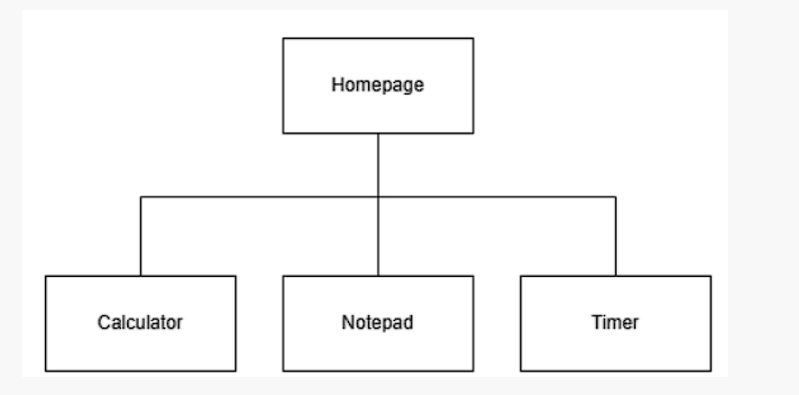

Slide 5
使用之技術
Front-end:
Html
Css
Javascript
Back-end:
node.js
Express.js
Database:
Mongodb atlas

Slide 6
特色
Notepad: add, delete list
By connecting it to database, that way when the user leave the page, the content will still remain.
Calculator : it is able to input by using keyboard
Timer : start, pause, reset
It is able to pause the timer halfway and press start again to resume

Slide 7
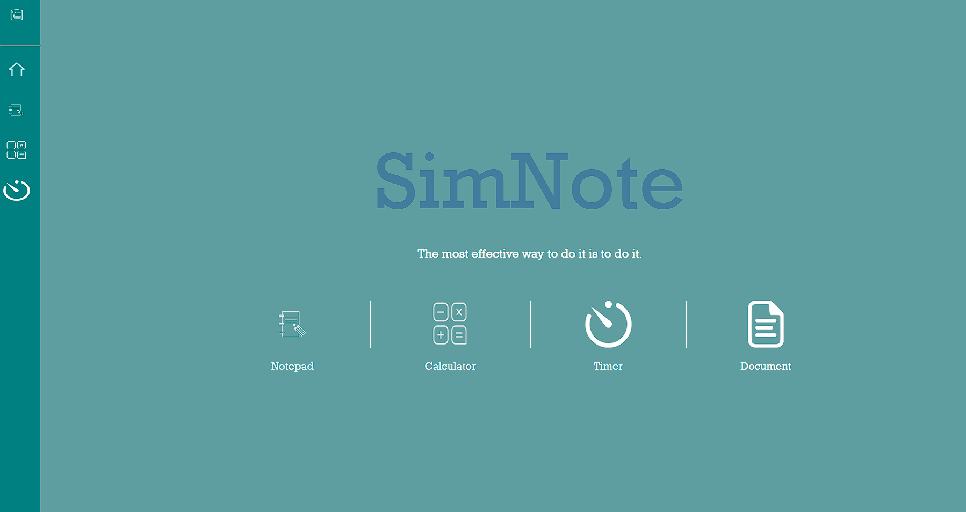
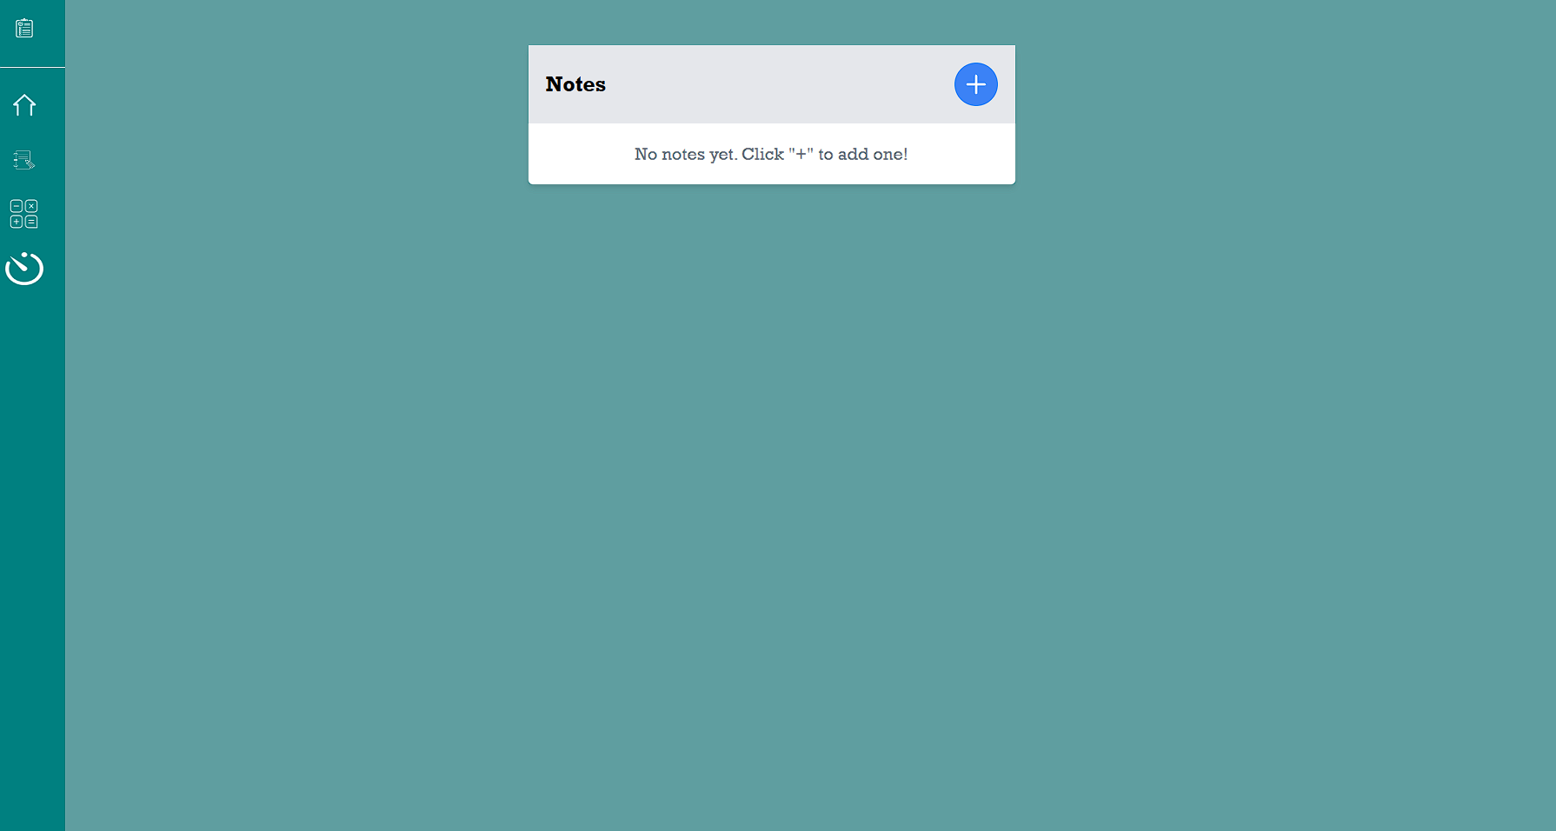
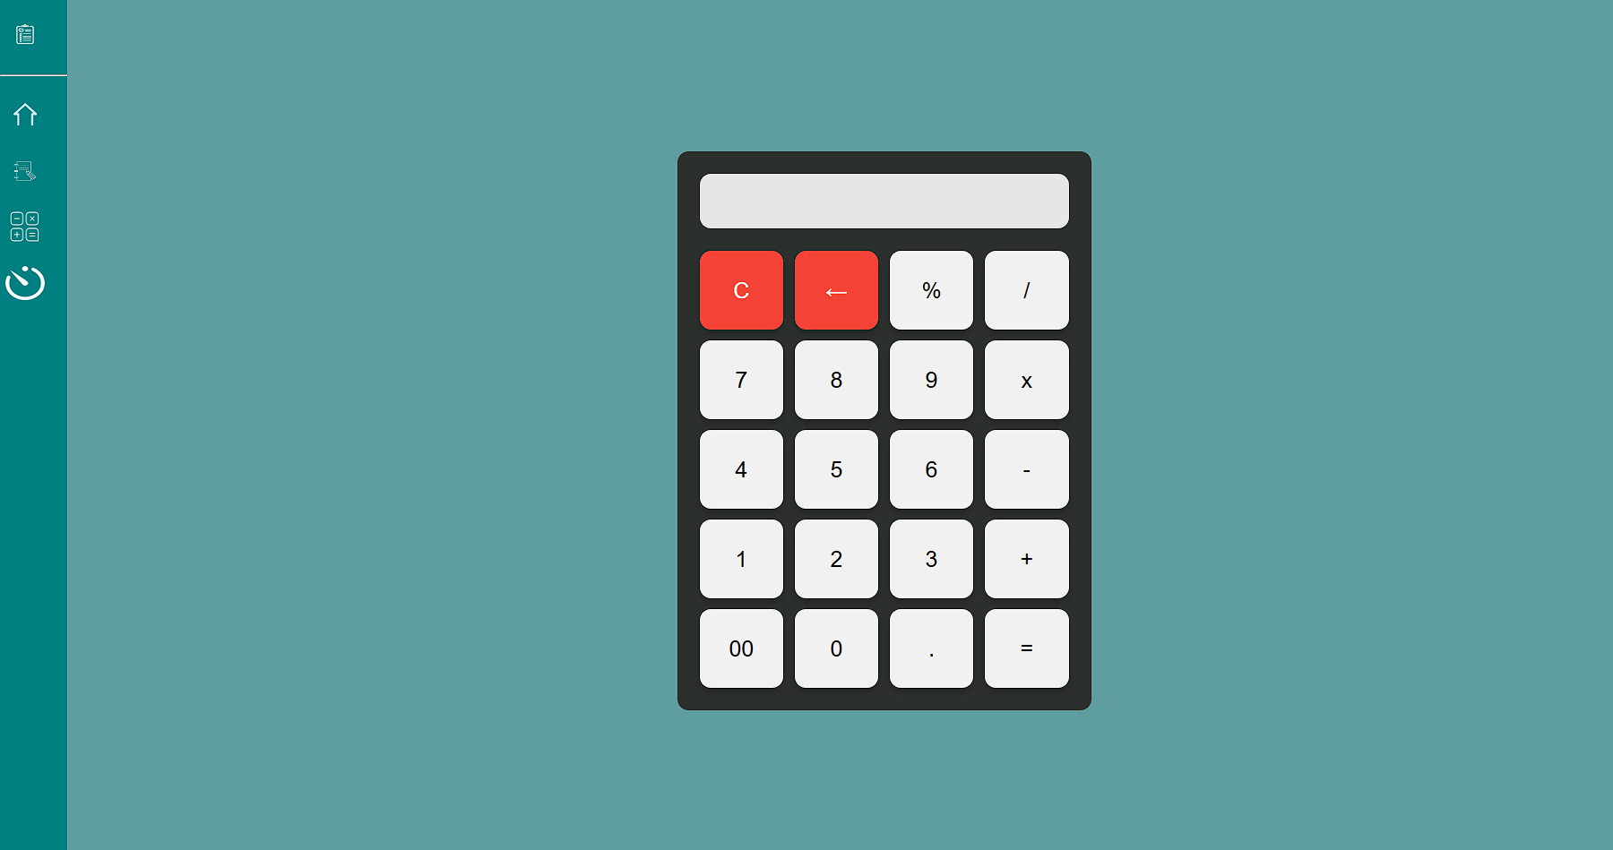
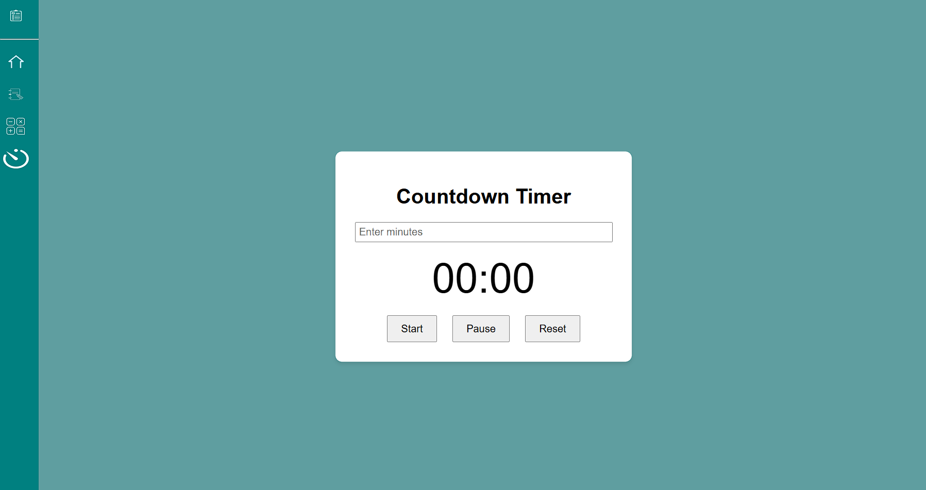

Slide 8
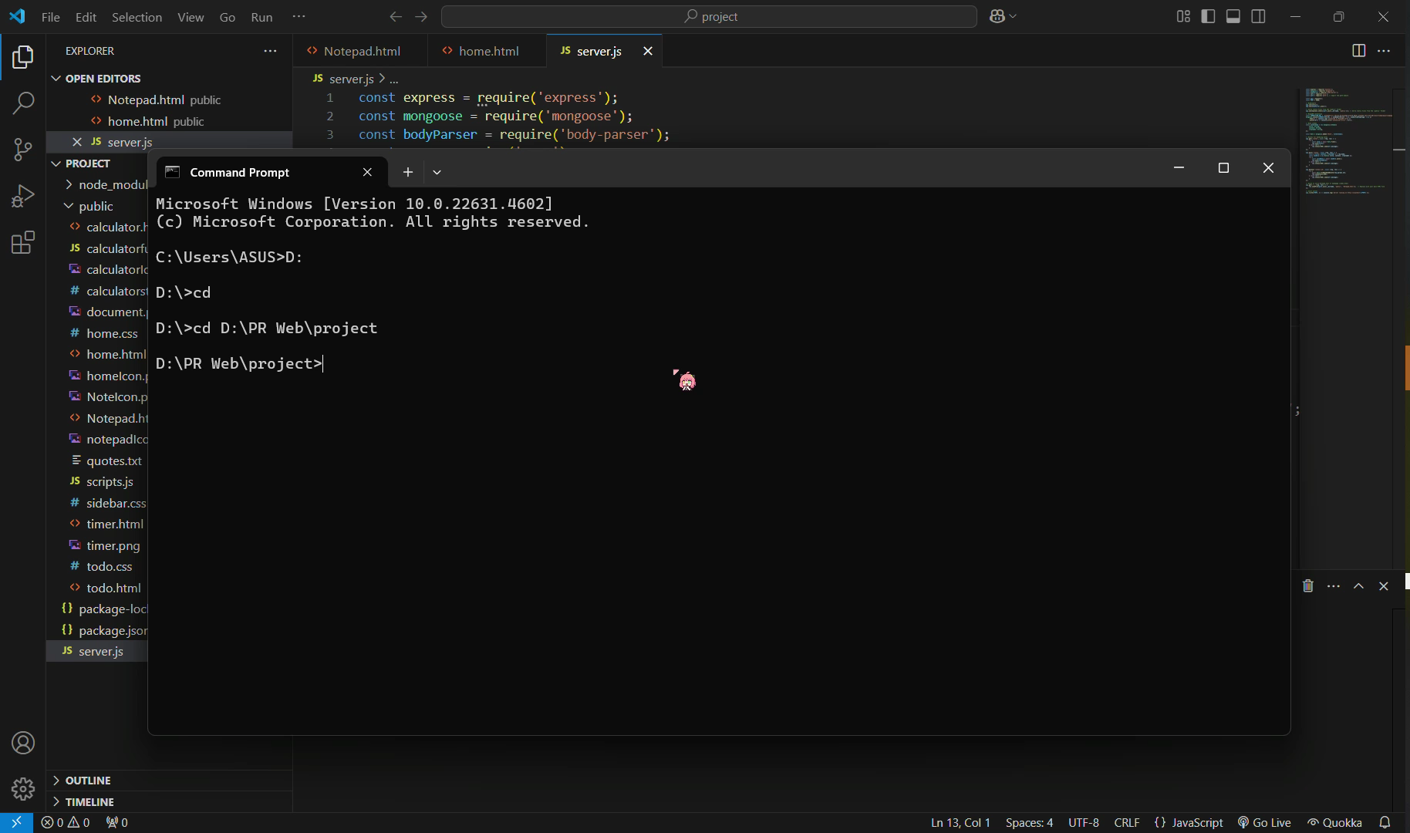

Slide 9
Notepad External links
<link href="https://cdn.jsdelivr.net/npm/tailwindcss@2.2.19/dist/tailwind.min.css" rel="stylesheet"> (used for css framework)
<script src="https://cdn.jsdelivr.net/npm/react/umd/react.production.min.js"></script>
<script src="https://cdn.jsdelivr.net/npm/react-dom/umd/react-dom.production.min.js"></script>(both used for reactdom, which is the notepad main function)
<script src="https://cdn.jsdelivr.net/npm/react/umd/react.production.min.js"></script>
<script src="https://cdn.jsdelivr.net/npm/react-dom/umd/react-dom.production.min.js"></script> (notepad javascript)

Slide 10
The end
Thank you

